Slide 1
S E K W A N G .
light.
dark.
HE
LLO.
MENU
Scroll
Notes:
[index.html] Region – main (CSS color: #FF5A5A, WhiteSmoke)

Slide 2
S E K W A N G .
Universities.
Academic Values.
Music.
Travel.
Contact.
skl072612@gmail.com
sekwang@postech.ac.kr
Notes:
Region - menu

Slide 3
S E K W A N G .
light.
dark.
HE
LLO.
MENU
Scroll
Notes:
[index.html] Region – main(darkmode) (CSS color: #FF5A5A, #323232(background), #282828)

Slide 4
S E K W A N G .
Universities.
Academic Values.
Music.
Travel.
Contact.
skl072612@gmail.com
sekwang@postech.ac.kr
Notes:
Region – menu(darkmode)

Slide 5
S E K W A N G .
Universities
light.
dark.
UNIVER
SITIES.
MENU
Scroll
Notes:
[universities.html] Universities – main (CSS color: #BE2457)

Slide 6
S E K W A N G .
Universities
Universities.
Academic Values.
Music.
Travel.
Contact.
skl072612@gmail.com
sekwang@postech.ac.kr
Notes:
Universities - menu

Slide 7
S E K W A N G .
Academic Values
light.
dark.
ACADEMIC
VALUES.
MENU
Scroll
Notes:
[academic.html] Academic Values – main (CSS color: #5AD18F)

Slide 8
S E K W A N G .
Academic Values
Universities.
Academic Values.
Music.
Travel.
Contact.
skl072612@gmail.com
sekwang@postech.ac.kr
Notes:
Academic Values - menu

Slide 9
S E K W A N G .
Music
light.
dark.
MU
SIC.
MENU
Scroll
Notes:
[music.html] Music – main (CSS color: #FFC846)

Slide 10
S E K W A N G .
Music
Universities.
Academic Values.
Music.
Travel.
Contact.
skl072612@gmail.com
sekwang@postech.ac.kr
Notes:
Music - menu

Slide 11
S E K W A N G .
Travel
light.
dark.
TRA
VEL.
MENU
Scroll
Notes:
[travel.html] Travel – main (CSS color: #6482FF)

Slide 12
S E K W A N G .
Travel
Universities.
Academic Values.
Music.
Travel.
Contact.
skl072612@gmail.com
sekwang@postech.ac.kr
Notes:
Travel - menu

Slide 13
S E K W A N G .
light.
dark.
HE
Region.
LL
MENU
Every day a little steadiness gathers, changing life as a whole.
prev. next.
Notes:
[index.html] Region – nextpage

Slide 14
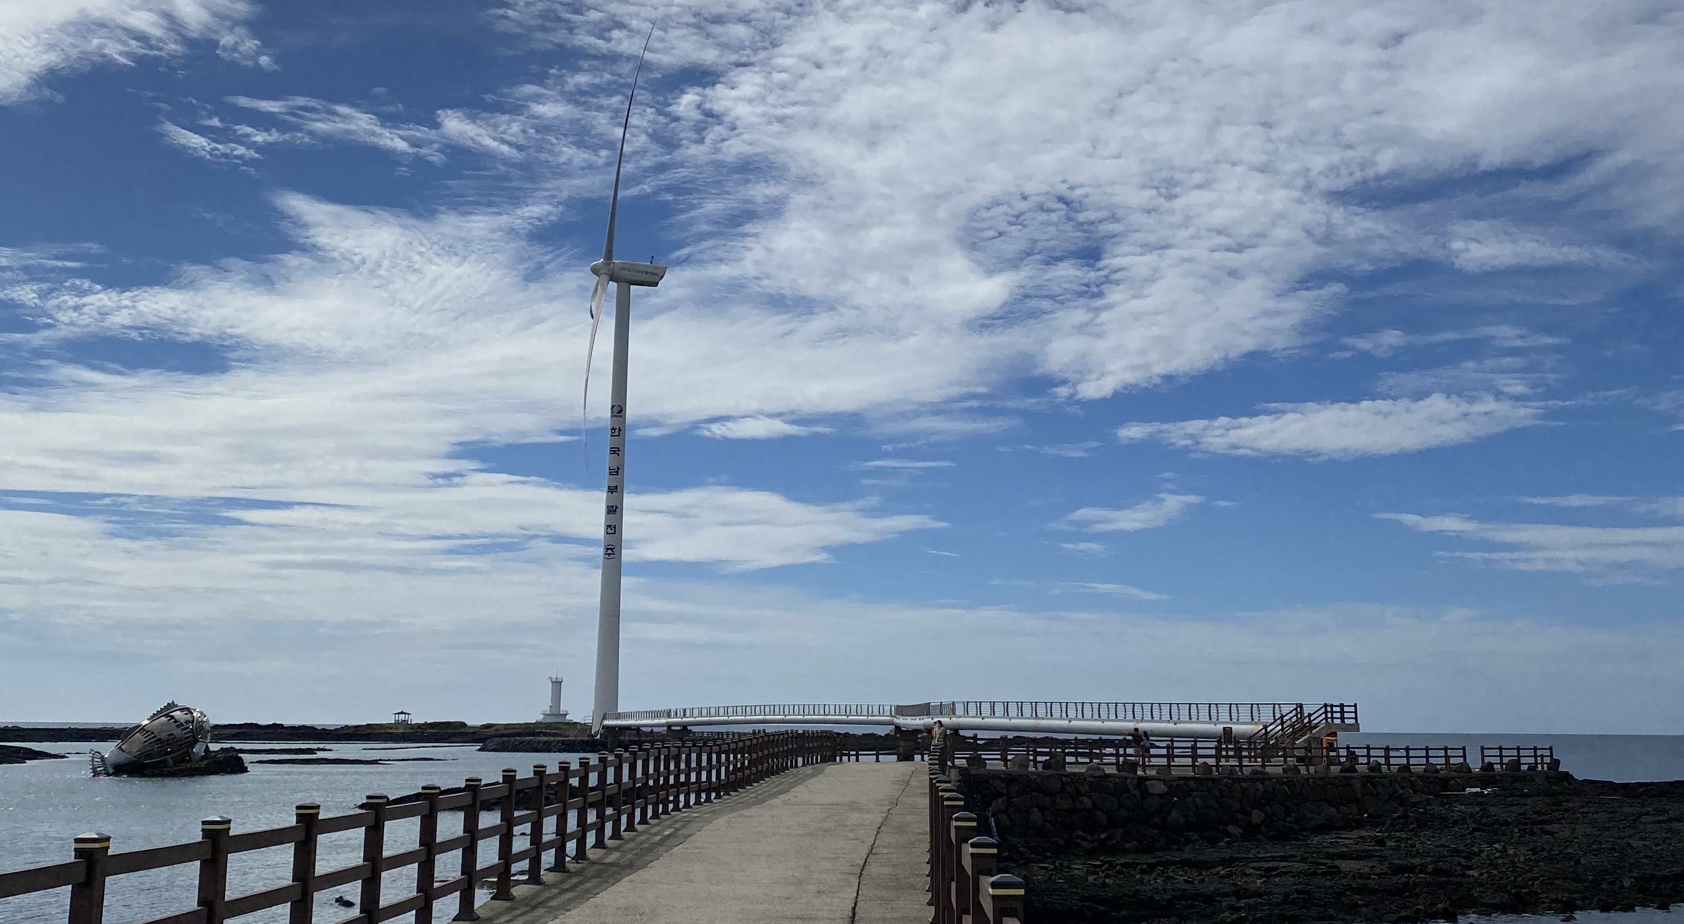
S E K W A N G .
light.
dark.
LIVE IN
MENU
JEJU.
prev. next.
Notes:
[index.html] Region – live1

Slide 15
S E K W A N G .
light.
dark.
LIVE IN
MENU
JEJU.
Notes:
[index.html] Region – live1(darkmode)

Slide 16
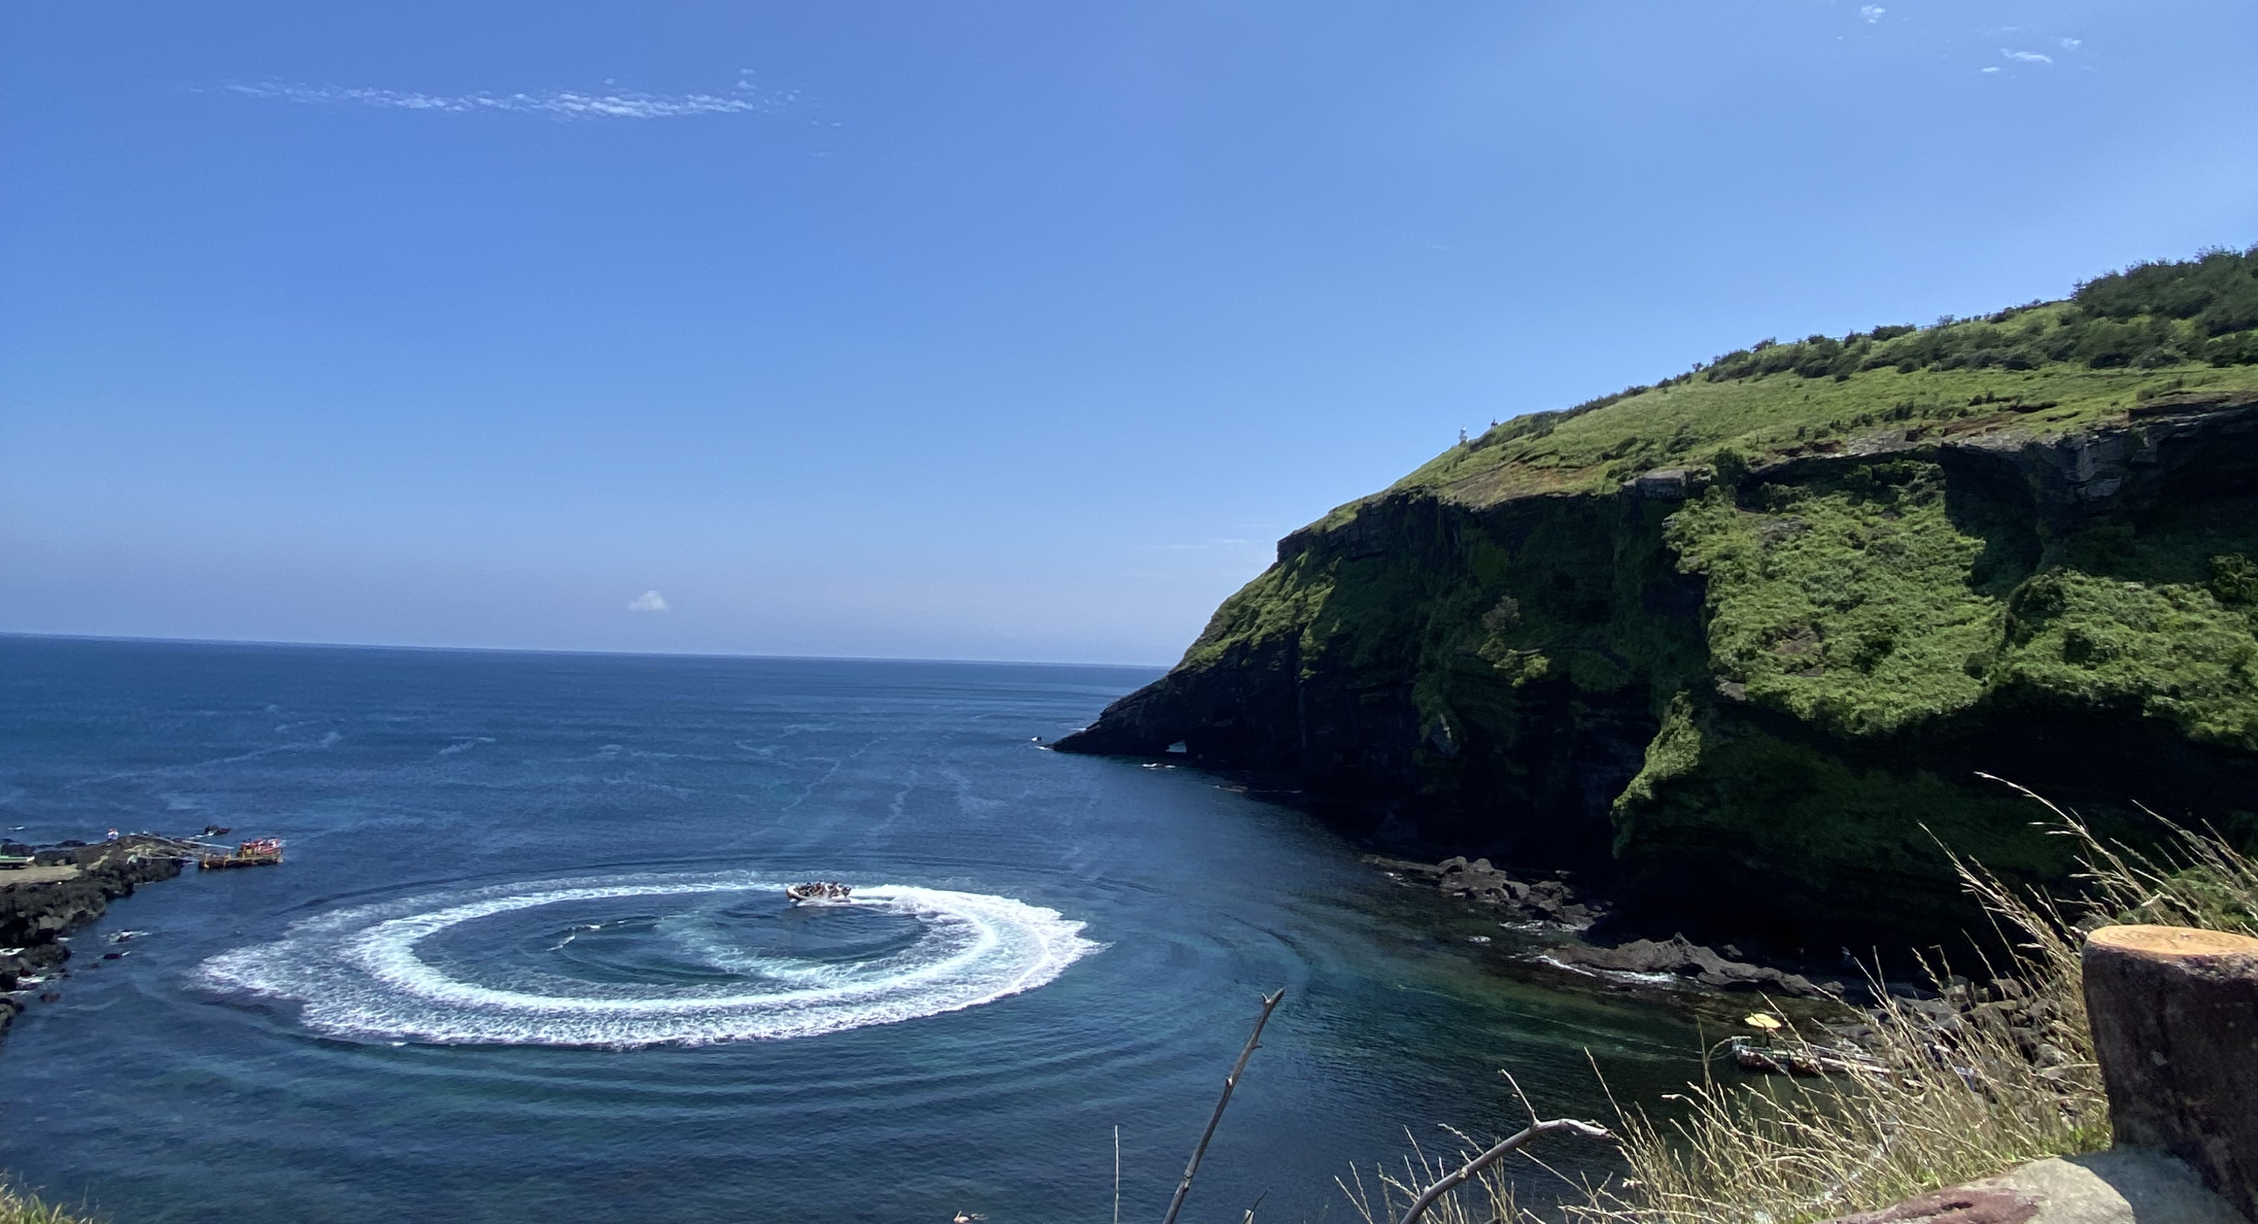
S E K W A N G .
light.
dark.
LIVE IN
MENU
JEJU.
Notes:
[index.html] Region – live2

Slide 17
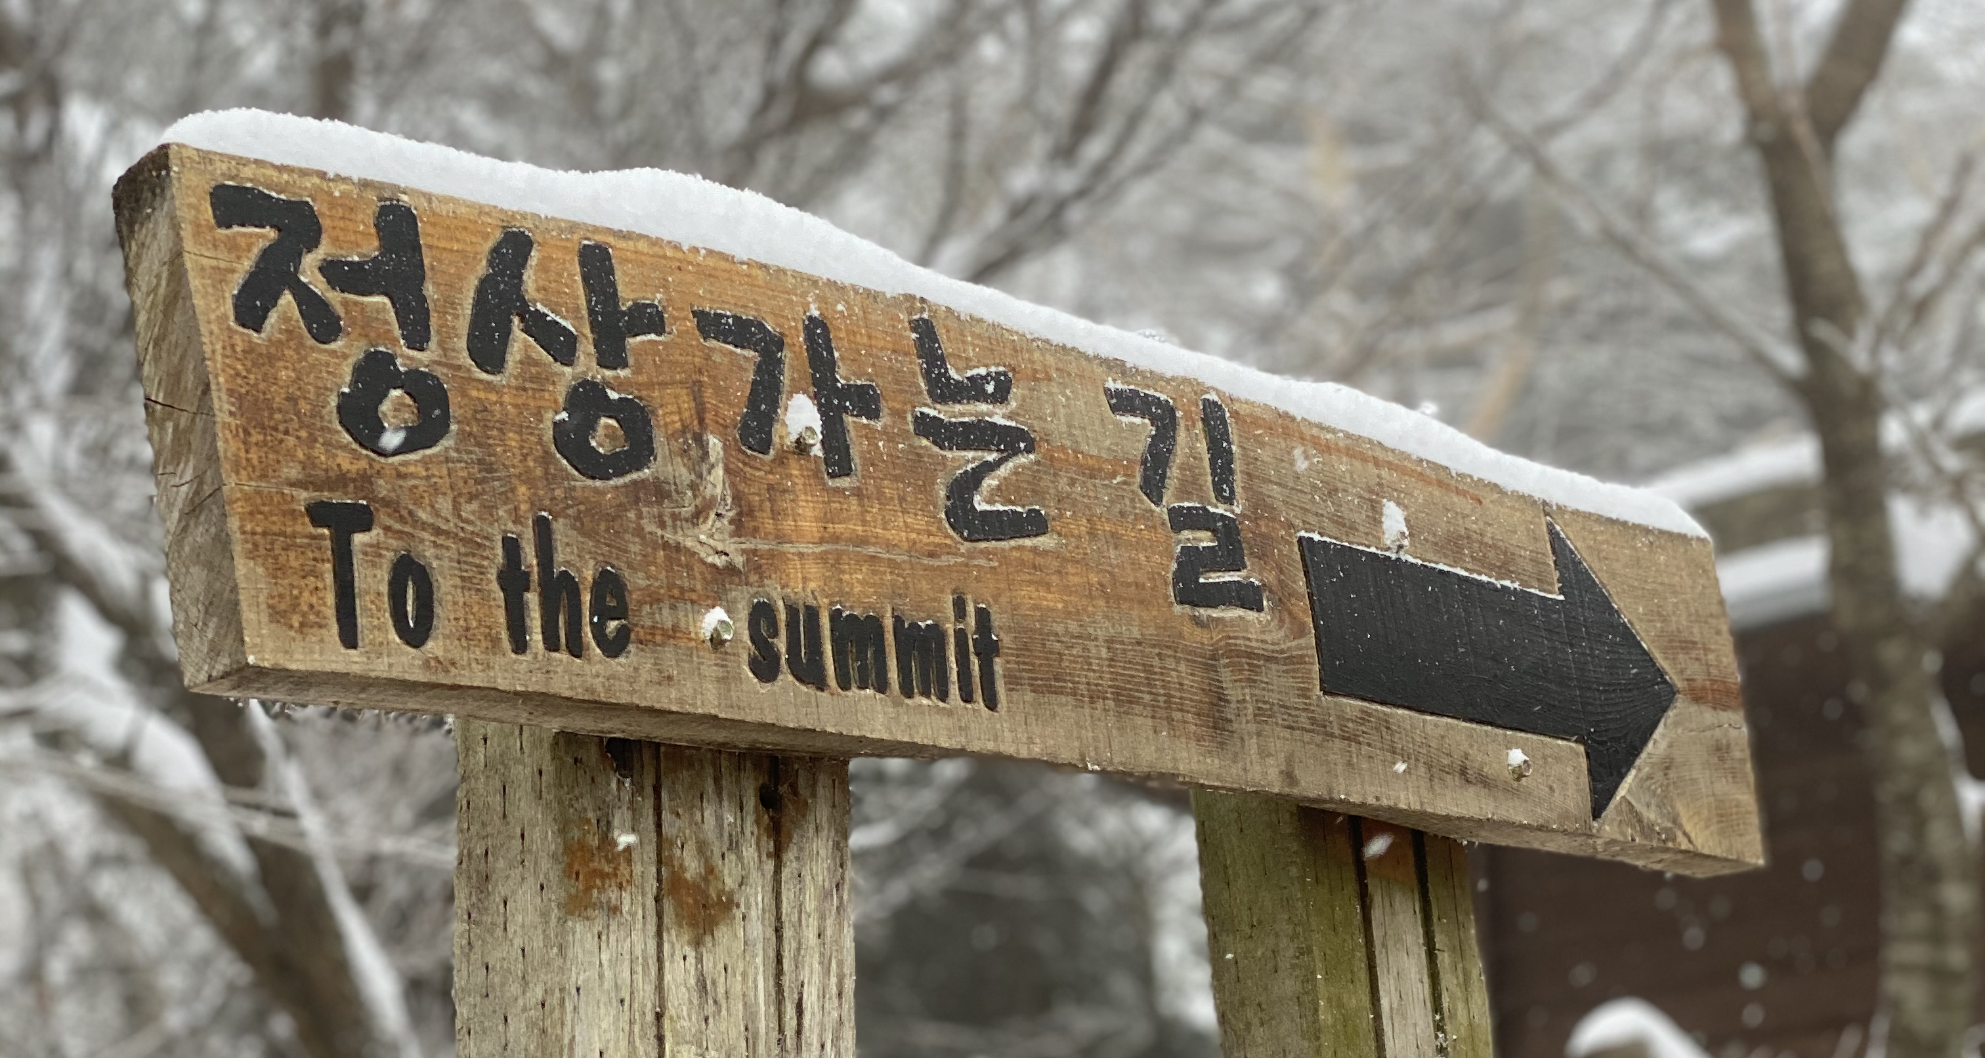
S E K W A N G .
light.
dark.
LIVE IN
MENU
JEJU.
Notes:
[index.html] Region – live2

Slide 18




S E K W A N G .
light.
dark.
TIME
LINE.
Noryangjin, Seoul
Bundang, Seongnam
Seogwipo, Jeju
MENU
2001 - 2003
2003 - 2011
2011 - current
Bukgu,
Gwangju
Jigok,
Pohang
2020 - 2021
2021 - current
Notes:
[index.html] Region – timeline (CSS color: #b4b4b4(line))

Slide 19
S E K W A N G .
light.
dark.
TIME
LINE.
Noryangjin, Seoul
Seogwipo, Jeju
Jigok,
Pohang
MENU
2001 - 2003
2003 - 2011
2011 - current
2020 - 2021
2021 - current
Bundang, Seongnam
Bukgu,
Gwangju
Notes:
[index.html] Region – timeline

Slide 20
S E K W A N G .
light.
dark.
TIME
LINE.
Noryangjin, Seoul
Seogwipo, Jeju
Jigok,
Pohang
MENU
2001 - 2003
2003 - 2011
2011 - current
2020 - 2021
2021 - current
Bundang, Seongnam
Bukgu,
Gwangju
Notes:
[index.html] Region – timeline(Darkmode)

Slide 21
S E K W A N G .
Universities
light.
dark.
Year / Department
2020 – 2021
Division of Liberal Arts and Sciences
Education
Like
Single Variable Calculus
Multi Variable Calculus
General Physics I / II
General Chemistry I
Computer Programming
Behavioral Economics
Conditions of Happiness
Academic Writing
Music / Guitar
GIST PLAYLIST
Travel
Riding
MENU
Club
Activities
GIST House
Start-Up Club (MOP)
Acoustic Band Club
C Programming Study
Basic Sort Algorithm Study
Start-Up Camp
Ideation
HTML + CSS + JavaScript Study
Basic Web Development
GIST Busking
Damyang / Naju Riding
Music Sharing Forum
Play ‘Fly Away’
Interest
Mechanical Engineering
Electrical Enginnering
Computer Enginnering
Biomimetics
Notes:
[universities.html] Universities – gist (CSS color: #FF7F50)

Slide 22
S E K W A N G .
Universities
light.
dark.
Year / Department
2021 – current
Mueunjae School of Undergraduate Studies
Education
Interest
Calculus I
General Physics I
General Chemistry I
Writing
Computer Engineering
Computer Vision
Machine Learning
Python Study
Algorithm
Biomimetics
Electrical Enginnering
Mechanical Engineering
MENU
Activities
C++ Programming Study
Using Github
Object-Oriented Programming Project
Basic Algorithm Study
Basic Web Publishing
Portfolio Website
Reading & Writing
Vacation Plan Project
Play ‘Autumn Leaves’
Play ‘Felicity’
Club
Mueunjae Student Council
Like
Music / Guitar
Travel
Notes:
[universities.html] Universities – postech (CSS color: #BE2457)

Slide 23
S E K W A N G .
Universities
light.
dark.
Interest
Activities
Computer Engineering
Computer Vision
Machine Learning
Python Study
Algorithm
Biomimetics
Electrical Enginnering
Mechanical Engineering
C++ Programming Study
Use Github
Object-Oriented Programming Project
Basic Algorithm Study
Basic Web Publishing
Portfolio Website
Reading & Writing
Vacation Plan Project
Play ‘Autumn Leaves’
Play ‘Felicity’
Year / Department
2020 – 2021
Mueunjae School of Undergraduate Studies
MENU
Like
Music / Guitar
Travel
Riding
Education
Club
Calculus I
General Physics I
General Chemistry I
Writing
Mueunjae Student Council
Notes:
[universities.html] Universities – gist (CSS color: #FF7F50)

Slide 24
S E K W A N G .
Universities
light.
dark.
Education
Activities
Single Variable Calculus
Multi Variable Calculus
General Physics I / II
General Chemistry I
Computer Programming
Behavioral Economics
Conditions of Happiness
Academic Writing
C Programming Study
Basic Sort Algorithm Study
Start-Up Camp
Ideation
HTML + CSS + JavaScript Study
Basic Web Development
GIST Busking
Damyang / Naju Riding
Music Sharing Forum
Play ‘Fly Away’
Year / Department
2020 – 2021
Mueunjae School of Undergraduate Studies
MENU
Like
Music / Guitar
Travel
Riding
prev.
next.
Interest
Club
Mechanical Engineering
Electrical Enginnering
Computer Enginnering
Biomimetics
GIST House
Start-Up Club (MOP)
Acoustic Band Club
Notes:
[universities.html] Universities – gist (CSS color: #FF7F50)

Slide 25
S E K W A N G .
Universities
light.
dark.
Interest
Activities
Computer Engineering
Computer Vision
Machine Learning
Python Study
Algorithm
Biomimetics
Electrical Enginnering
Mechanical Engineering
C++ Programming Study
Use Github
Object-Oriented Programming Project
Basic Algorithm Study
Basic Web Publishing
Portfolio Website
Reading & Writing
Vacation Plan Project
Play ‘Autumn Leaves’
Play ‘Felicity’
MENU
Like
Music / Guitar
Travel
Riding
Year / Department
2021 – current
Mueunjae School of Undergraduate Studies
Education
Club
Calculus I
General Physics I
General Chemistry I
Writing
Mueunjae Student Council
Notes:
[universities.html] Universities – gist (CSS color: #FF7F50)

Slide 26
S E K W A N G .
light.
dark.
Education
Interest
Calculus I
General Physics I
General Chemistry I
Writing
Computer Engineering
Computer Vision
Machine Learning
Python Study
Algorithm
Biomimetics
Electrical Enginnering
Mechanical Engineering
Activities
MENU
C++ Programming Study
Using Github
Object-Oriented Programming Project
Basic Algorithm Study
Basic Web Publishing
Portfolio Website
Reading & Writing
Vacation Plan Project
Play ‘Autumn Leaves’
Play ‘Felicity’
Club
Mueunjae Student Council
Like
Music / Guitar
GIST PLAYLIST
Travel
Notes:
[universities.html] Universities – postech(darkmode) (CSS color: #BE2457)

Slide 27




S E K W A N G .
light.
dark.
MENU
C
C++
Python
Git
Notes:
[academic.html] Academic Values – sklills1(darkmode) (CSS Color: #323232(background))

Slide 28
S E K W A N G .
Academic Values
light.
dark.
MENU
C
C++
Python
Git
Notes:
[academic.html] Academic Values – sklills1

Slide 29
S E K W A N G .
Academic Values
C
C++
Python
Git
Notes:
[academic.html] Academic Values – sklills1

Slide 30




S E K W A N G .
Academic Values
light.
dark.
MENU
HTML
CSS
JavaScript
jQuery
Notes:
[academic.html] Academic Values – sklills2

Slide 31




S E K W A N G .
Academic Values
light.
dark.
MENU
Power
Point
illustrator
Premiere Pro
iMovie
Notes:
[academic.html] Academic Values – sklills3

Slide 32


S E K W A N G .
Academic Values
light.
dark.
MENU
GarageBand
Audacity
Notes:
[academic.html] Academic Values – sklills4

Slide 33


S E K W A N G .
Academic Values
light.
dark.
MENU
Excel
Fusion
360
Notes:
[academic.html] Academic Values – sklills (CSS color: F)

Slide 35
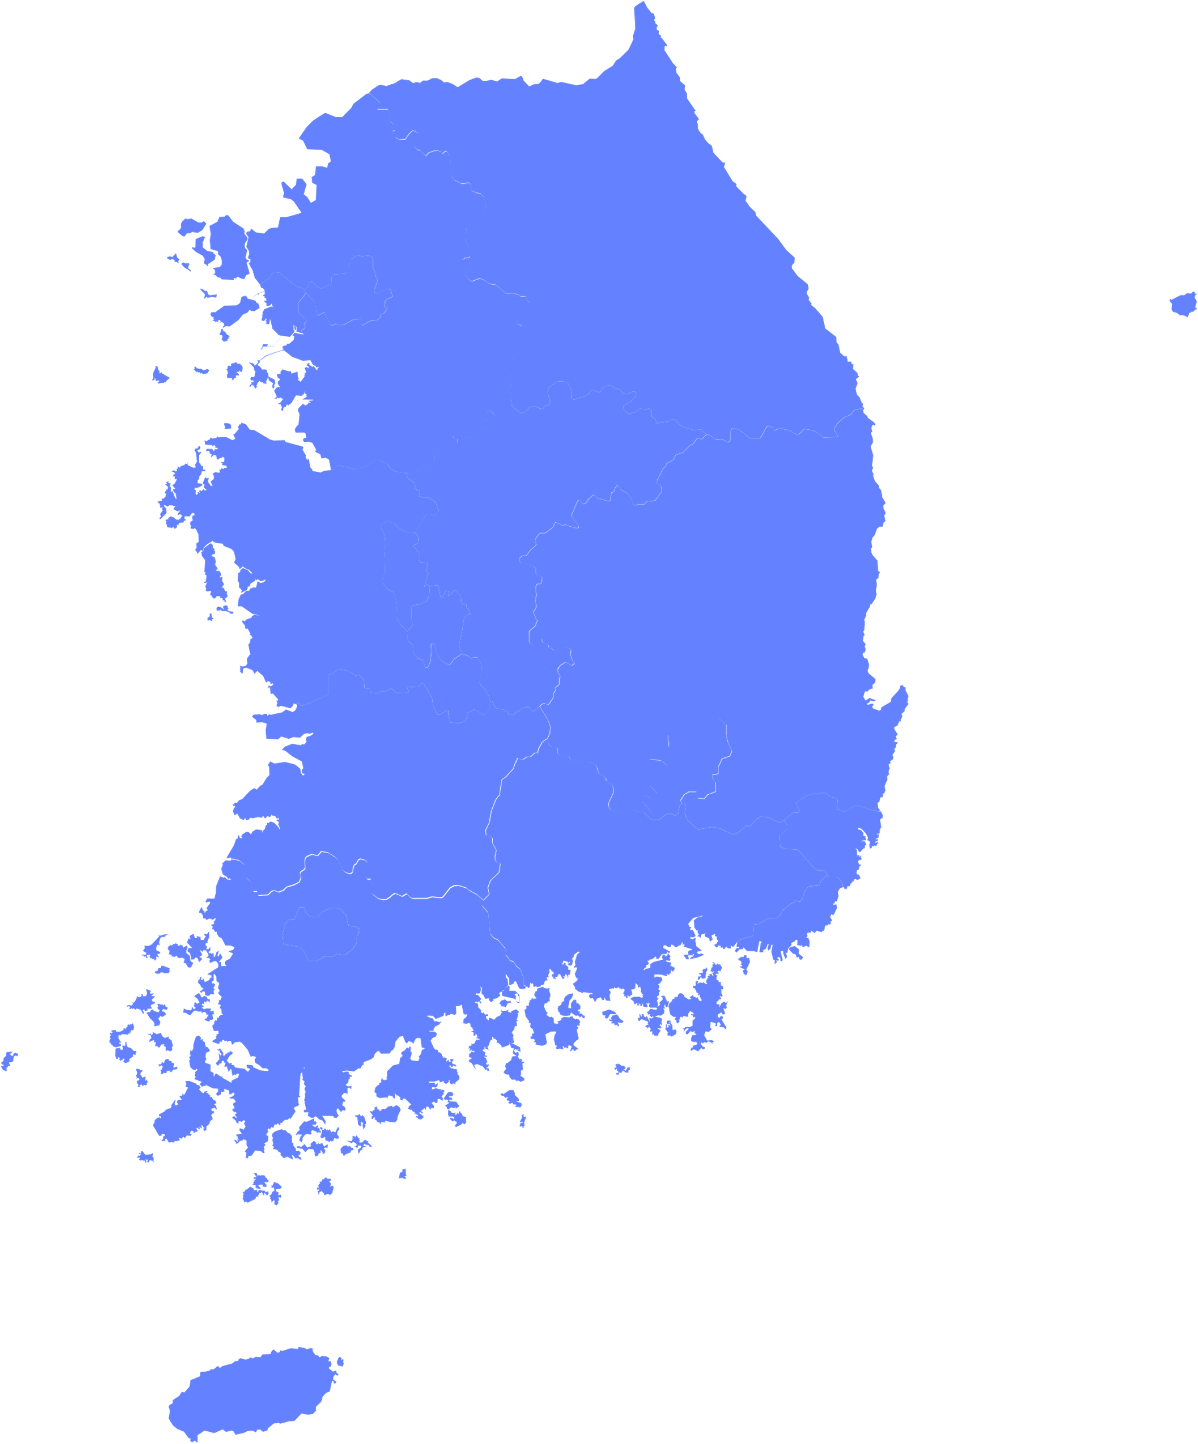
S E K W A N G .
Travel
light.
dark.
Gangwon-do
Seoul / Incheon / Gyeonggi-do
Chungcheongnam-do
Daejeon / Chungcheongbuk-do
Daegu / Gyeongsangbuk-do
MENU
Jeollabuk-do
Gwangju / Jeollanam-do
Busan / Gyeongsangnam-do
Jeju-do
Notes:
[travel.html] Travel – korea

Slide 36
S E K W A N G .
Travel
light.
dark.
Gangwon-do
Seoul / Incheon / Gyeonggi-do
Chungcheongnam-do
Daejeon / Chungcheongbuk-do
Daegu / Gyeongsangbuk-do
MENU
Jeollabuk-do
Gwangju / Jeollanam-do
Busan / Gyeongsangnam-do
Jeju-do
Notes:
[travel.html] Travel – korea(darkmode)

Slide 37
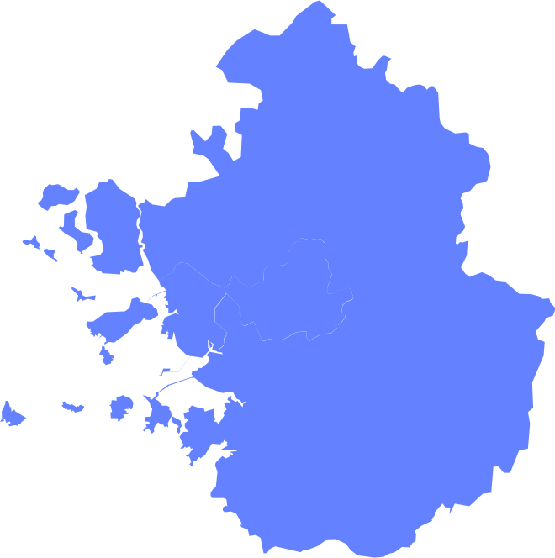
S E K W A N G .
Travel
light.
dark.
Paju
MENU
Seoul
Hanam
Incheon
Yangpyeong
Seongnam
Gwacheon
Ansan
Gwangju
Suwon
Yongin
Yeoju
Icheon
Anseong
Notes:
[travel.html] Travel – korea

Slide 38

S E K W A N G .
Travel
light.
dark.
Yanggu
Sokcho
Chuncheon
MENU
Gangneung
Pyeongchang
Jeongseon
Samcheok
Taebaek
Notes:
[travel.html] Travel – korea

Slide 39
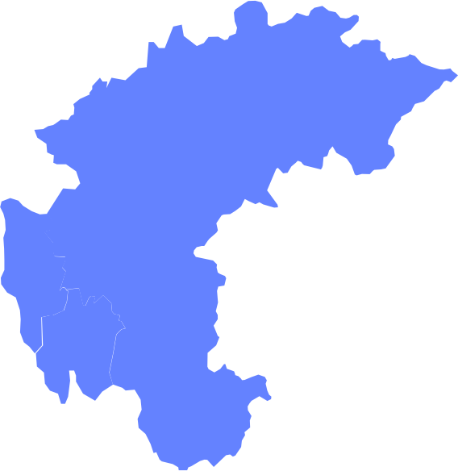
S E K W A N G .
Travel
light.
dark.
Chungju
MENU
Cheongju
Daejeon
Notes:
[travel.html] Travel – korea

Slide 40
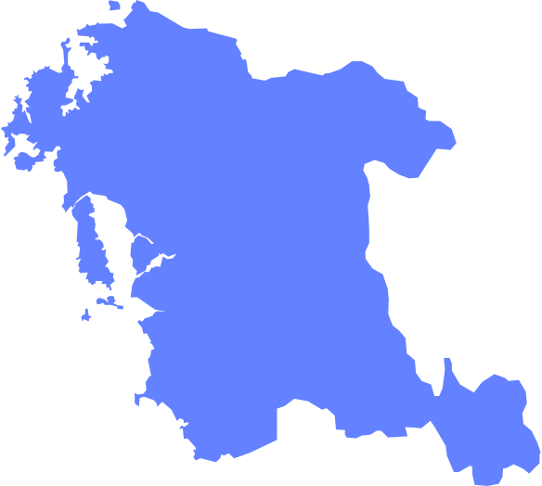
S E K W A N G .
Travel
light.
dark.
Asan
MENU
Gongju
Gyeryong
Seocheon
Notes:
[travel.html] Travel – korea

Slide 41

S E K W A N G .
Travel
light.
dark.
Andong
MENU
Pohang
Daegu
Gyeongju
Notes:
[travel.html] Travel – korea

Slide 42
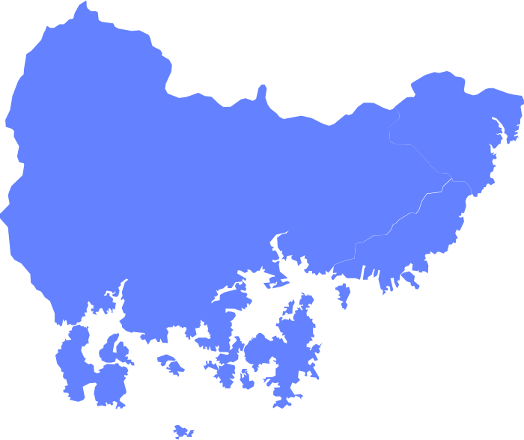
S E K W A N G .
Travel
light.
dark.
Hamyang
Ulsan
Miryang
Changwon
Gimhae
MENU
Busan
Jinju
Geoje
Namhae
Tongyeong
Notes:
[travel.html] Travel – korea

Slide 43

S E K W A N G .
Travel
light.
dark.
Muju
Jeonju
MENU
Jeongeup
Namwon
Notes:
[travel.html] Travel – korea

Slide 44
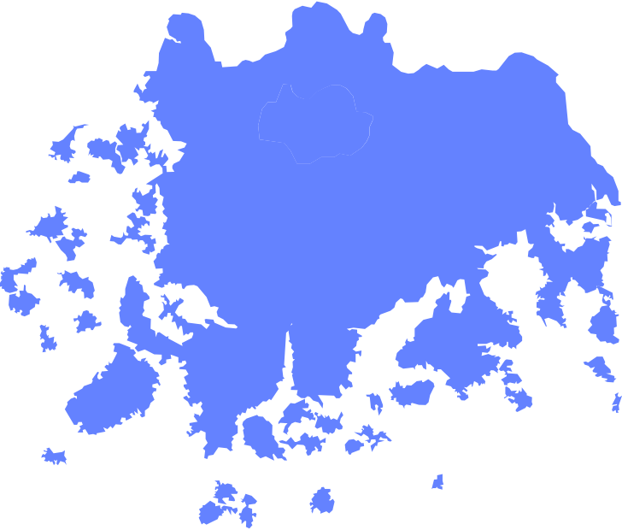
S E K W A N G .
Travel
light.
dark.
Damyang
Gwangju
Naju
Suncheon
Boseong
MENU
Mokpo
Yeosu
Wando
Notes:
[travel.html] Travel – korea

Slide 45

S E K W A N G .
Travel
light.
dark.
Jeju
MENU
Seogwipo
Notes:
[travel.html] Travel – korea

Slide 46
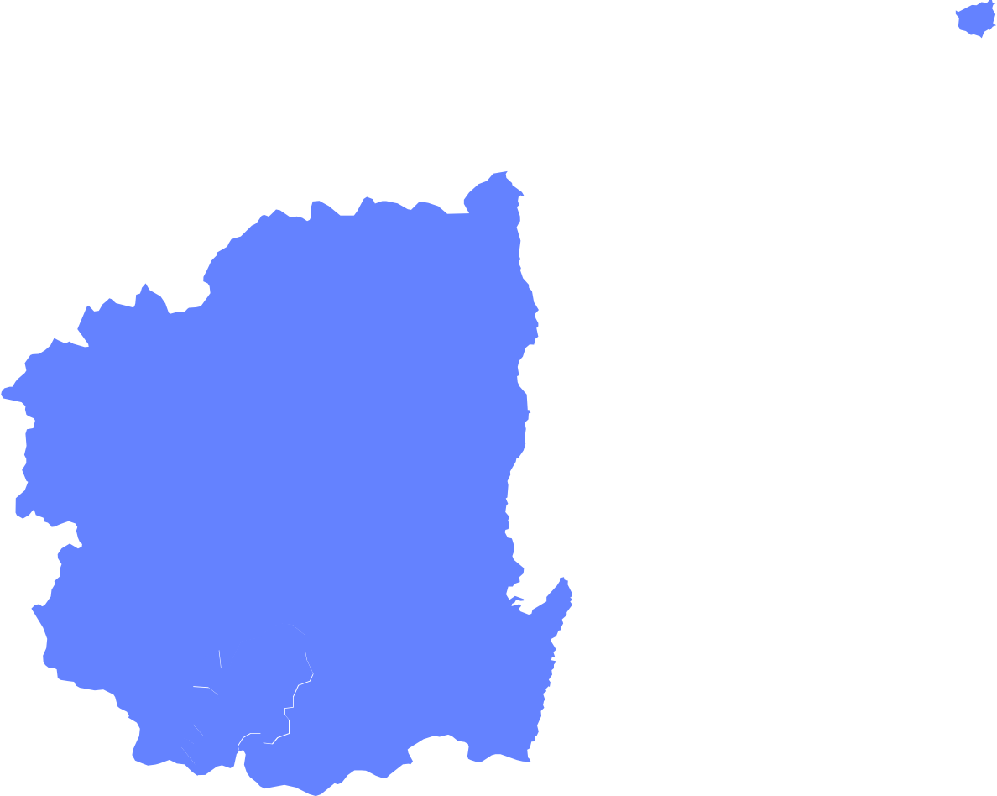
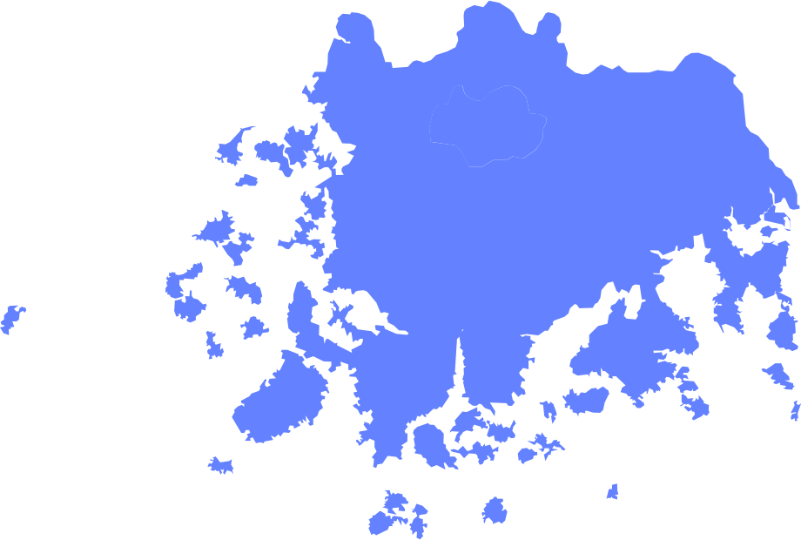

Slide 47
S E K W A N G .
Music
light.
dark.
400+
PLAYLIST.
MENU
prev.
next.
OOHYO
Notes:
[music.html] Music – playlist (CSS color: #FFC846)

Slide 48
S E K W A N G .
Music
light.
dark.
400+
PLAYLIST.
MENU
Jang Beom June
prev.
next.
Notes:
[music.html] Music – playlist (CSS color: #FFC846)

Slide 49
S E K W A N G .
Music
light.
dark.
400+
PLAYLIST.
MENU
OOHYO
prev.
next.
Notes:
[music.html] Music – playlist (CSS color: #FFC846)

Slide 51

S E K W A N G .
Music
light.
dark.
FINGERSTYLE
GUITARIST.
MENU
prev.
Fingerstyle
Instagram
Sunny
Notes:
[music.html] Music – guitar (CSS color: #FFC846)

Slide 52
S E K W A N G .
Music
light.
dark.
FINGERSTYLE
GUITARIST.
MENU
Fingerstyle
Instagram
- Englishman in New York -
prev.
Notes:
[music.html] Music – guitar (CSS color: #FFC846)

Slide 53
S E K W A N G .
Music
light.
dark.
OOHYO
MENU
OOHYO
400+
PLAYLIST.
prev.
next.
Notes:
[music.html] Music – playlist (CSS color: #FFC846)

